Slide 1
AI in Astrophotography
Dale A. Chamberlain
www.chamberlainobservatory.com

Slide 2
What is AI (Artificial Intelligence)
Machines capable of perception, logic, and learning
Machine learning employs algorithms that learn from data to make predictions or decisions and whose performance improves when exposed to more data over time
Deep learning uses many-layered neural networks to build algorithms that find the best way to perform tasks on their own based on vast sets of data
Definition from Intel Corporation

Slide 3
AI applications in photography
AI allows the developer to focus on solving the problem rather than coding for it
AI has been a part of digital photography for some time now
Adobe Photoshop CC
Topaz DeNoise AI, Gigapixel AI, Sharpen AI, etc.
DxO DeepPrime
AI used in graphic arts
Builds images based on a plethora of images, including stock photos by using text descriptions provided by the maker
Not true photography
MidJourney, StableFusion and many others
Not what we will be discussing in this presentation

Slide 4
Where is AI in Astrophotography?
Astrophotography has lagged behind the photography industry in adopting AI
Many astrophotographers have used Topaz Denoise AI
Topaz Denoise AI does an excellent job for non-astrophotos but lacks features needed for astrophotography
Topaz AI neural networks were not trained using astrophotos
Russ Croman’s RC-Astro introduced AI to astrophotography
StarXterminator
NoiseXterminator
Most recently, BlurXterminator (deconvolution)
All use neural networks built with carefully selected astro images
The neural network is continuously learning from new images over time, and they are released to the user base as new databases

Slide 5
What are the advantages of AI over past methods?
Again, it allows the developer to focus on solving the problem (noise reduction, deconvolution, star recognition) rather than writing code.
Think of it as a different approach to solving the mathematical problems we face in digital image processing
Eliminates tedious guesswork in running the traditional PixInsight processes (use of masks, wavelet layers, switches and dials)
Yields much better results in much less time
Virtually free of processing artifacts
And it is using YOUR image data without replacing any part of it with another image
Deconvolution is about recovering fine-scale image signal buried in low contrast
It is NOT large-scale recovery such as the multiscale functions in PixInsight
BXT only recovers detail if the detail exists in your data at low contrast

Slide 6
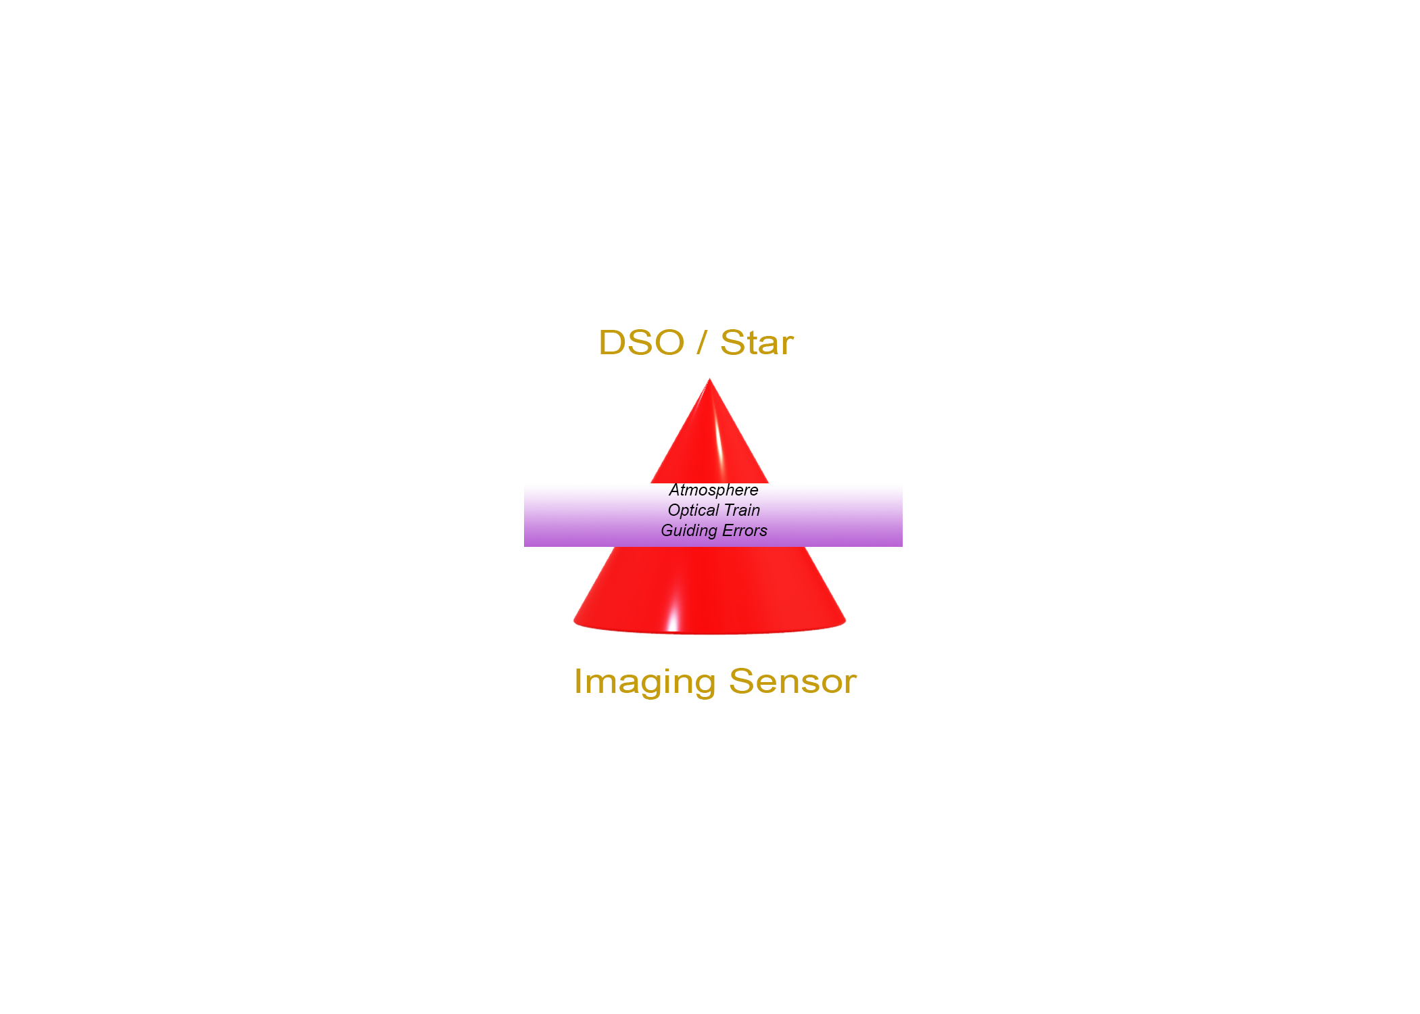
Importance of PSF in BXT (Deconvolution)
The ideal point spread function (PSF) is the three-dimensional diffraction pattern of light emitted from an infinitely small point source in space and transmitted to the image plane through a high numerical aperture objective.
Think of PSF as a cone where light is diffracted through the atmosphere and an optical train, causing the light to spread beyond the center spike of the cone. Stars are selected for the PSF since they represent a tiny point of light in the overall image.
Deconvolution is never perfect, but it reduces the spread of light captured on the imaging sensor, resulting in clearer structures and tighter stars.
PSF is expressed as the FWHM (Full Width Half Maximum)

Slide 7
Hardware
Will run on any Windows, Mac or Linux platform
Easy to install in PixInsight
Updates are automatic
Windows platforms with NVIDIA Graphics GPU will speed up processing significantly
Install CUDA 11.8 (NOT 12.0!)
Follow Russ Croman’s instructions on BXT for enabling CUDA support
My image processing computer is an AMD Ryzan 9 5950 with 32 logical processors, 128GB RAM, NVMe storage and a NVIDIA RTX 3080 Graphics card

Slide 8
Workflow Considerations
BlurXterminator (BXT) should be used early in post-processing
After integration of images, Channel Combination, cropping, DBE/GraXpert, Color Calibration but before noise reduction while in a linear state
AI Training was performed on images before noise reduction
Most accurate if given the FWHM of the image rather than relying on AutoPSF
Use Hartmut Bornemann PSFImage script on RGB
Use PI’s FWHMEccentricity script on monochrome
Use on luminance (either acquired or extracted)
Can be used on RGB images – new revision allows for the selection of luminance only for RGB images
Look Ma! No masks!
BXT can correct aberrations caused by
Guiding errors
Astigmatism
Primary and Secondary coma
Chromatic aberrations
Varying FWHM star diameters and halos in each color channel

Slide 9
Workflow Considerations
NoiseXterminator (NXT)
While in a linear state after BXT
Immediately after permanent histogram stretching – non-linear
StarXterminator (SXT)
Anytime when processing is better on a starless image or when a star mask is needed
Can be done in linear and non-linear states
Recommended to use “unscreen” mode if reblending stars back into the starless image
PixelMath: ~((~starless)*(~stars))

Slide 10
Links
Russ Croman’s RC-Astro site: www.rc-astro.com
Russ Croman’s AI Presentation to AIC https://www.youtube.com/watch?v=JlSUVJI93jg
Adam Block Interview with Russ Croman: https://youtu.be/6hkVBnYYlss
RC-Astro page on GPU acceleration: www.rc-astro.com/resources/gpu_nn_acceleration.php
PixInsight: www.pixinsight.com
Hartmut Bornemann scripts: www.skypixels.at/pixinsight_scripts.html
Using New Processes to Improve Image Quality in Post Processing: https://chamberlainobservatory.com/using-new-processes-to-improve-image-quality-in-post-processing/
Chamberlain Observatory: www.chamberlainobservatory.com/

