Slide 1
Astrophotography II Capturing the Final Frontier
By Dale A. Chamberlain

Slide 2
Overview
Building an Observatory
Equipment
Image Acquisition
Image Pre processing
Image Post Processing
A few images of heavenly bodies

Slide 3
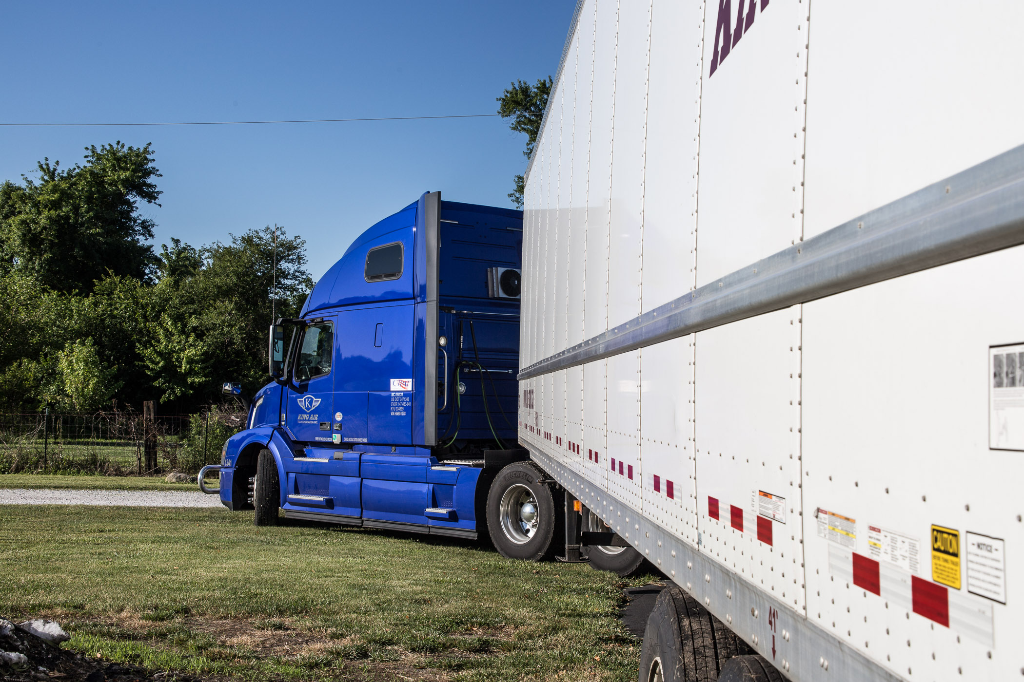
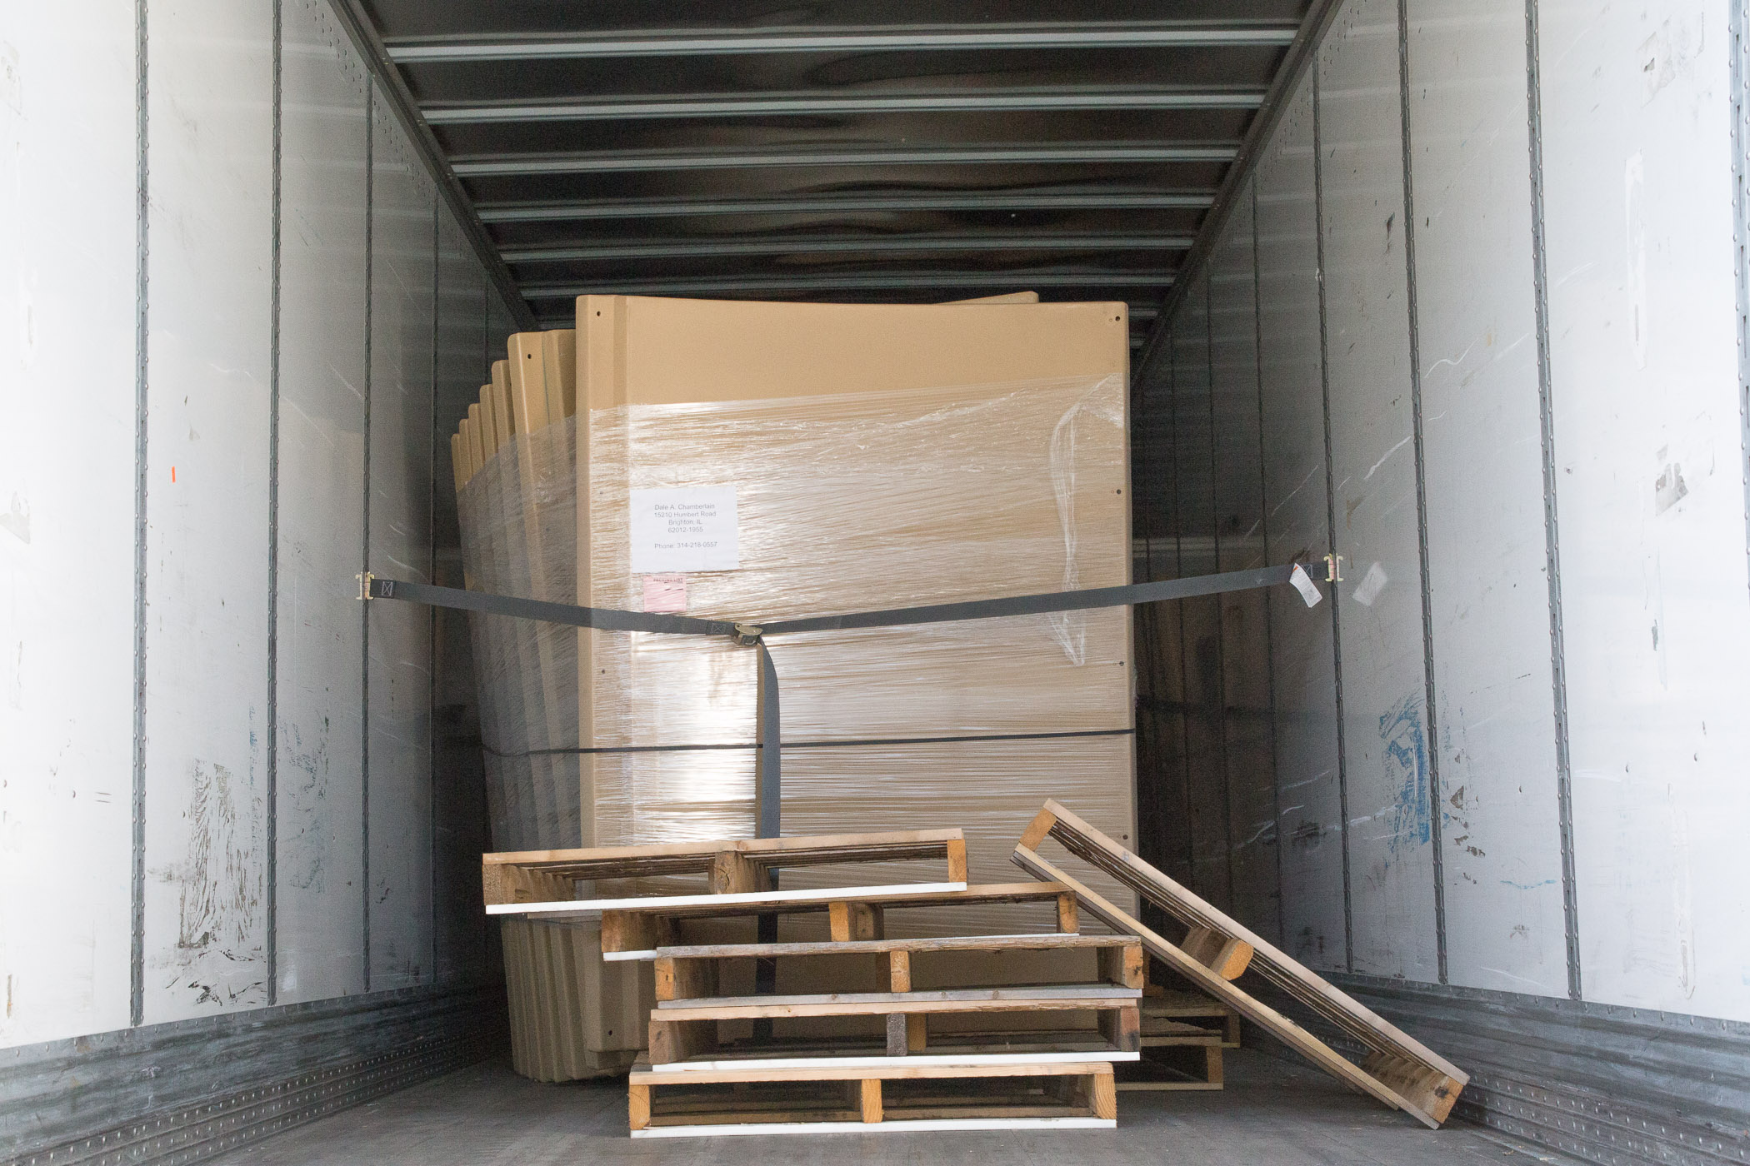
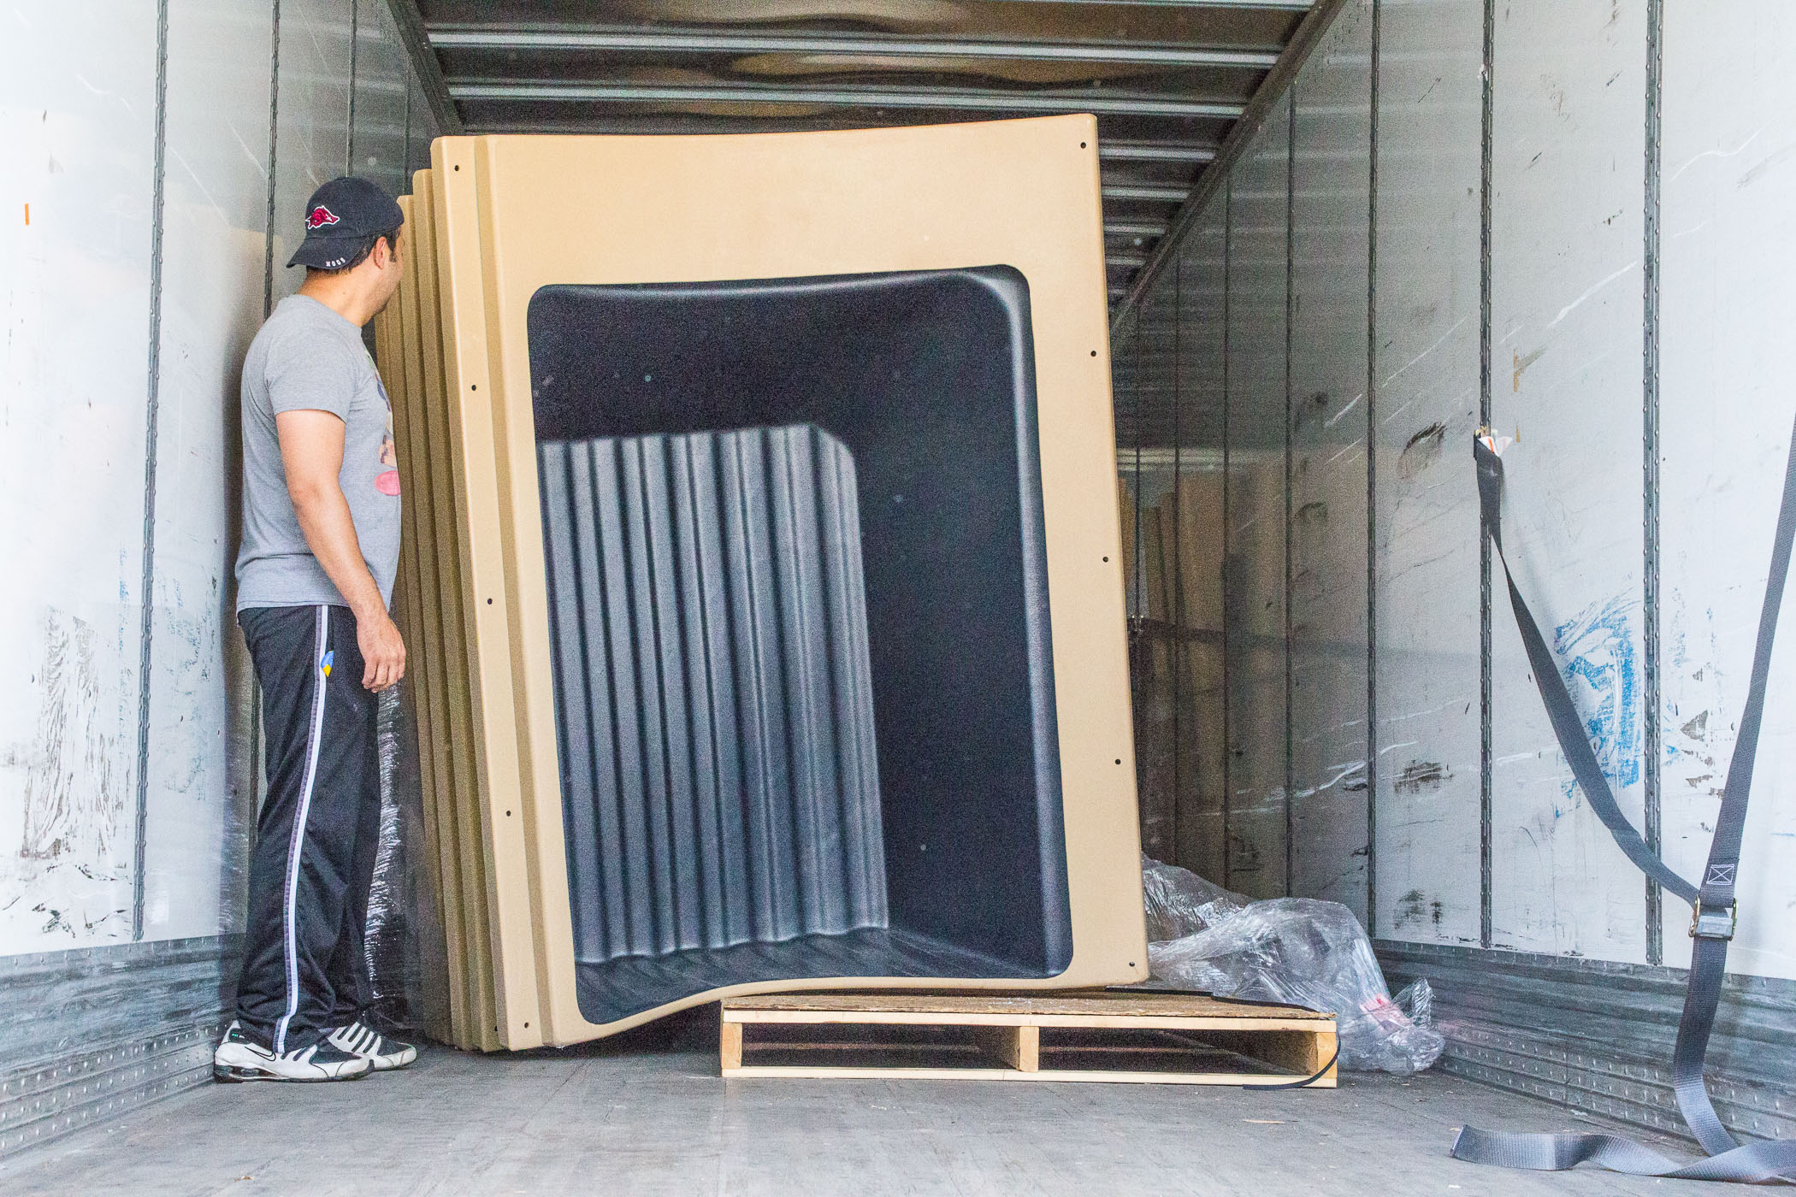
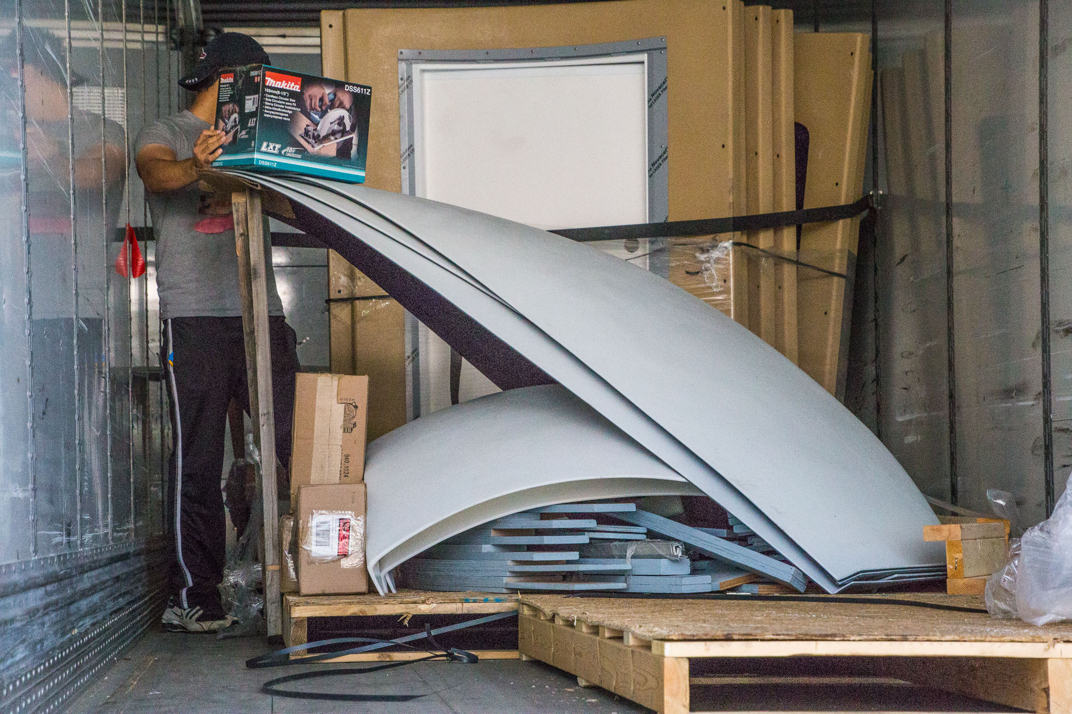
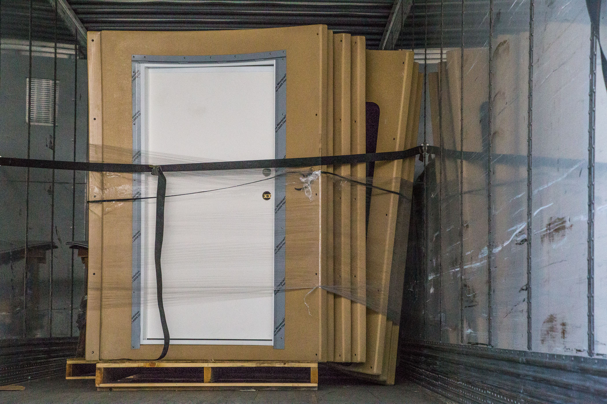
Building An Observatory
Materials for the POD MAX observatory shipped from Canada and arrived on June 27, 2017
First POD MAX erected in the United States
Construction began July 13, 2017 and ended November 6
Dome automation system arrived December 18, 2017 and installed in March 2018.
Observatory is 12 ½ feet around, 12 ½ feet high

Slide 4
Building An Observatory … Not for the faint of heart!
Delays due to waiting for building instructions and weather
First adopter woes:
Missing parts
Finding errors in instructions
Some components modified after shipment
Fortunately had help from people with construction/engineering background and excellent support from tech vendors
New technology learning curve
New technology not working as designed
First dome control smoked when turned on!

Slide 5
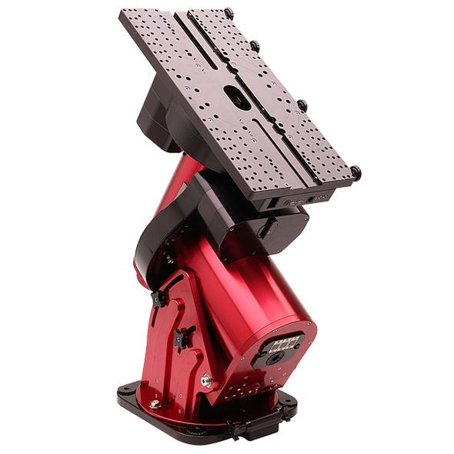
Equipment
Mount
Paramount ME II - 240 lb total instrument capacity
The mount controls the movement of the telescope
It is attached to the steel pier and the telescope attaches to the mount
It must be calibrated and polar aligned before use
A computer controls the mount using TheSkyX Pro software

Slide 6
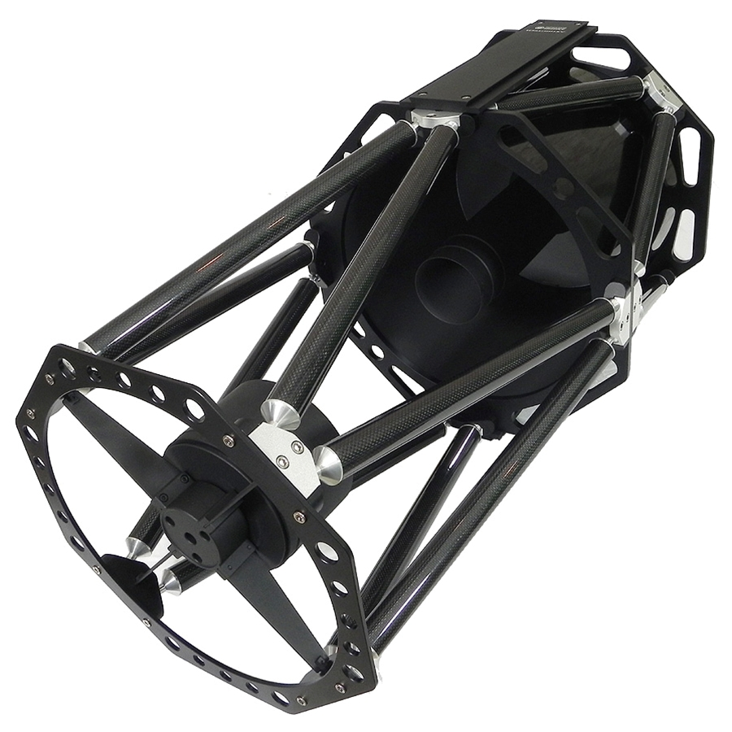
Equipment
Telescope
Astro-Tech 14” RC (Ritchey-Chrétien)
Optical specifications: 14” aperture, 2850mm focal length, f/8 focal ratio prime lens
Carbon fiber truss-tube design
Hyperboloid primary and secondary mirror

Slide 7
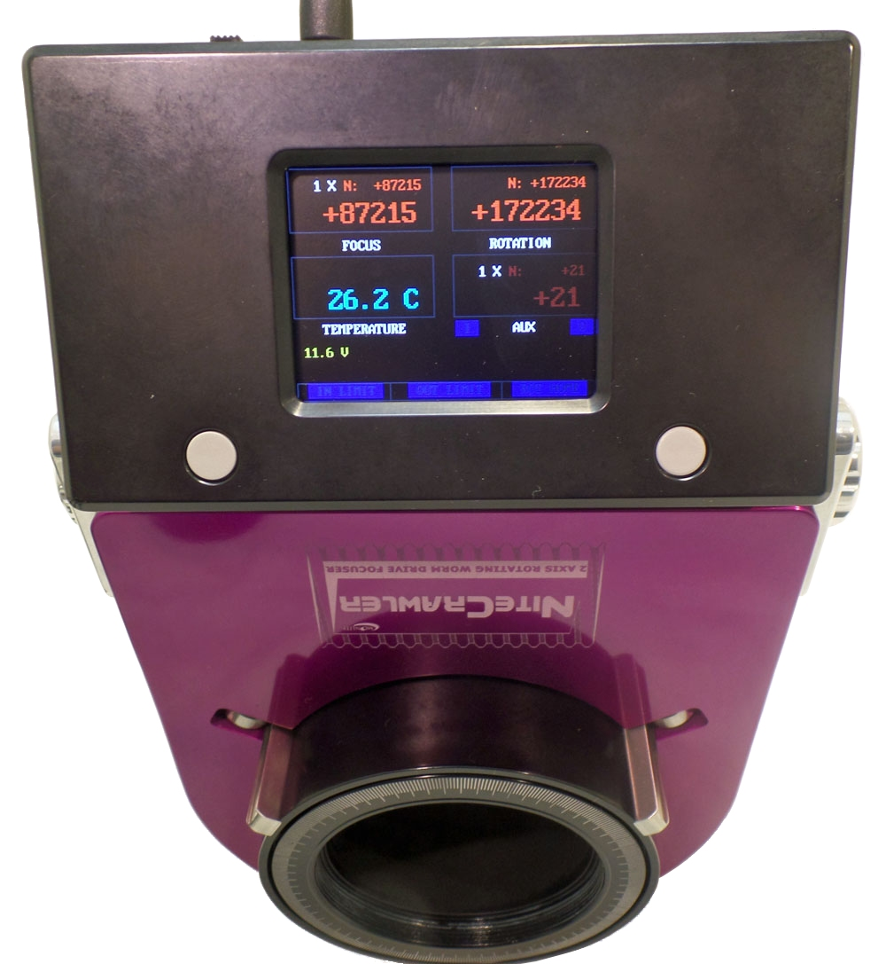
Equipment
Focuser
Moonlite Nitecrawler model WR25
Extreme position accuracy that is repeatable down to .26 microns
Provides focus and optics rotation by manual or computer control

Slide 8
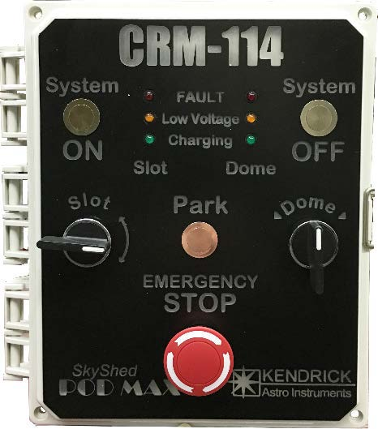
Equipment
Dome Control
Kendrick Astro Instruments PODMAX CRM-114 control
2 separate computers interfaced via Bluetooth control dome rotation and slot cover opening and closing
Interfaces to PC to keep the observatory slot opening where the telescope is pointing

Slide 9
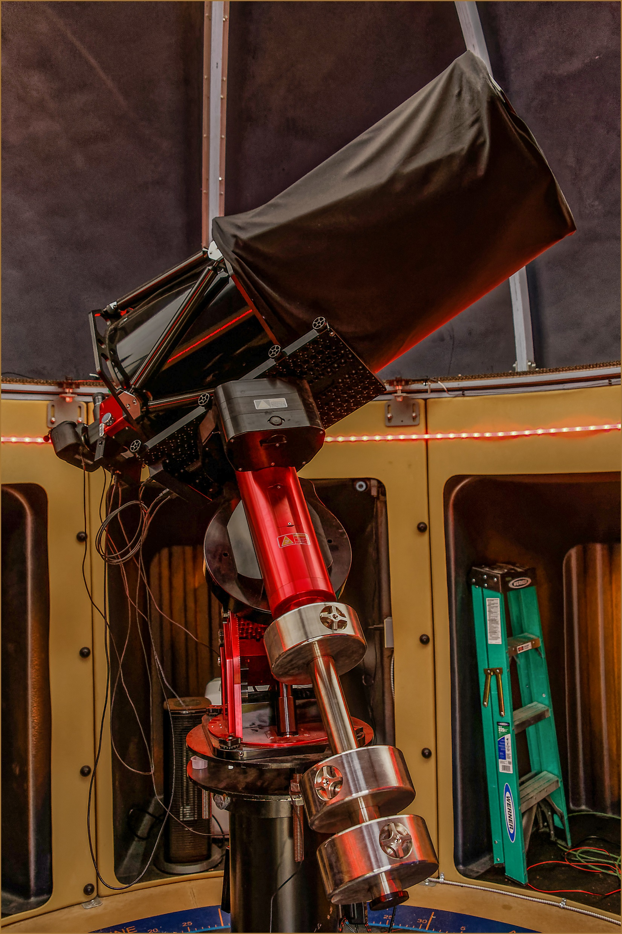
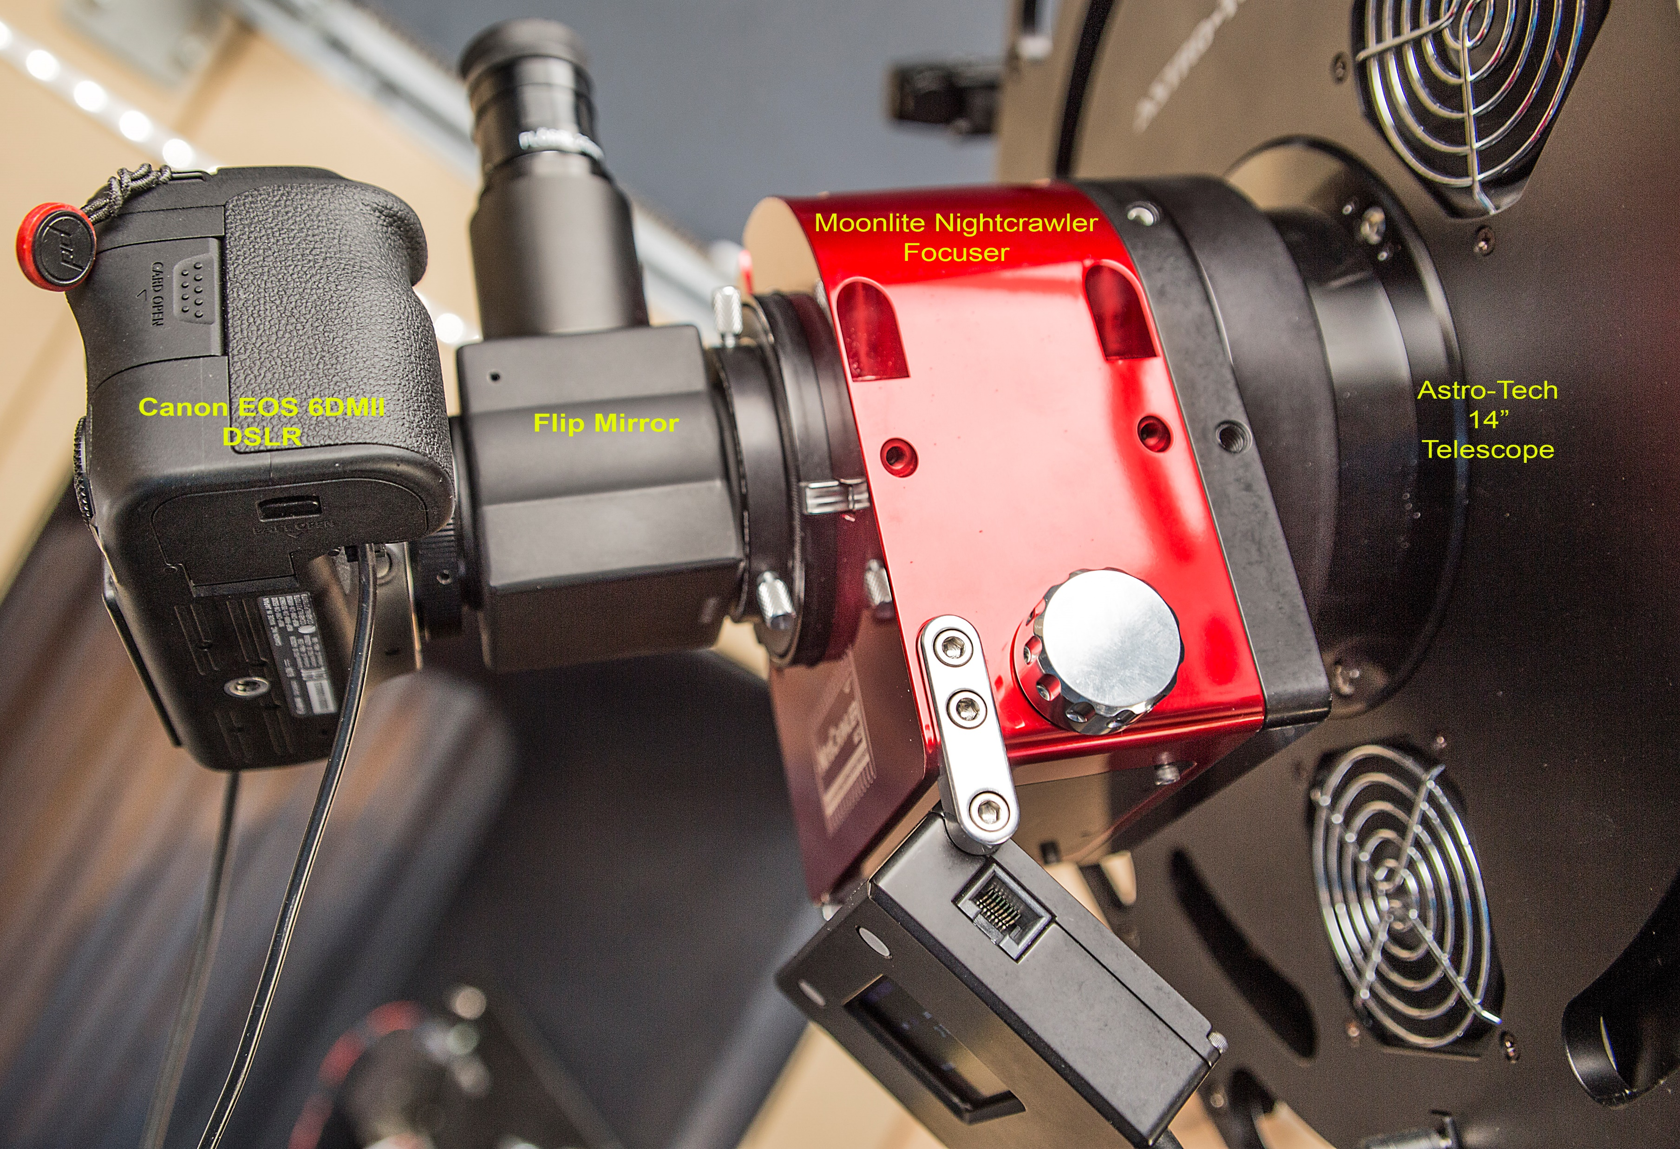
All Together
The optical train---From celestial object to camera sensor

Slide 10
What do you see when you look through the eyepiece? (Camera sees things your eye doesn’t)
The Orion Nebula – Messier 42

Slide 11
Image Acquisition
Image Acquisition software is TheSkyX Pro from Bisque
My camera: Canon EOS 6D Mark II
Camera set to BULB mode if exposure time is greater than 30 seconds
Camera set to MANUAL mode if exposure time is 30 seconds or less
Turn on Long Exposure Noise Reduction in camera
There are 4 types of exposures that need to be taken: LIGHT, DARK, FLAT and BIAS
Use TheSkyX Pro software running on the computer to control the camera settings and shutter release, as well as telescope, dome and focuser control
LIGHT frames are the images of the object in the sky you are photographing
DARK frames are images taken with the lens opening covered (only time it is acceptable to not remove the lens cap before taking pictures!)
FLAT frames are taken while it is still light outside using a light box or light diffuser. I use the translucent slot cover of the observatory.
BIAS frames are like LIGHT frames except you are using the fastest shutter speed capable of the camera (1/4000 for the Canon 6D)

Slide 12
Image Acquisition
LIGHT frames
Actual image data of the object you are photographing
Light frames straight out of the camera have imperfections that must be removed
Vignetting, dust, thermal noise, bias signal, hot pixels, etc.
Problems with light frames can be remedied by calibrating with dark, bias and flat frames.
Light frames can be stacked into a single image once calibrated
Example of a LIGHT frame

Slide 13
Image Acquisition
DARK frames
A way to minimize image noise for long exposure images
Fixed-pattern noise is the same from shot to shot, dead or hot pixels
Take a series of shots with the cap on (no light getting to the sensor from the outside)
Each shot should be the same ISO and exposure time as your LIGHT images
Ideally, they are taken at the same ambient temperature as the light images.
DARK frames are subtracted from the light frames during calibration.
Example of a DARK frame

Slide 14
Image Acquisition
FLAT frames
Why FLAT frames?
We need to correct optical imperfections (i.e. caused by telescope, instead of ones with the camera sensor).
Telescopes do not distribute light evenly across the sensor (vignetting)
Any dust on the sensor must be removed
Must be taken with the same focus, camera orientation and optical setup as the light frames

Slide 15
Image Acquisition
FLAT frames
To be taken while there is still light in the sky if using a light box or observatory slot cover. Computer screen can be used too http://whitedisplay.com/
Camera mode is set to Aperture Priority
Set exposure compensation to +2EV
ISO is set low (100,200) to minimize noise
Try to get images where the histogram is close to the center
Camera is connected to the scope
Maintain same focus as you would use for the LIGHT frames
Shoot a minimum of 30-50 FLAT frames
FLAT frames will be stacked together and divided into the light frames
Illumination of the LIGHT frame is evened out
Example of a FLAT frame

Slide 16
Image Acquisition
BIAS frames
Used to remove the readout signal from your sensor
Variations in how the camera reads data from the sensor
Each shot is taken as close to zero exposure length as possible for the camera (i.e. the fastest shutter speed for my Canon 6D Mark II is 1/4000 second.)
Each shot is taken at the same ISO as the DARK and LIGHT images.
It is not necessary to take these at the same ambient temperature as the DARK and LIGHT images.
Will be subtracted from all other images before stacking begins
Example of a BIAS frame

Slide 17
Image Preprocessing
Calibrate, Integrate (stacking) and Registration
Software used is PixInSight from Pleiades Astrophoto
Calibrate and integrate BIAS frames to create a Super BIAS
Calibrate and integrate DARK frames using Super BIAS to create a Master DARK image
Calibrate and integrate FLAT frames using Super BIAS and Master DARK
Super BIAS, Master DARK and Master FLAT all will be used in processing each LIGHT frame
LIGHT frames are calibrated, and registered (aligned with each other) and finally stacked to create one final image

Slide 18
Image Post processing
Software used: Adobe Photoshop CC
Making adjustments to the stacked, calibrated and registered image
No set workflow since objects vary in size and light intensity
Typical adjustments to white balance, shadows, highlights, sharpness, contrast etc.
No color changes except saturation. Colors as detected by camera sensor are natural.
Hydrogen shows as red, oxygen shows as green/teal

Slide 19
First visit: The Moon
Taken October 26, 2017
Single exposure, 1/80 sec, ISO 100
248,467 miles away
No computer used, telescope aimed by hand

Slide 20
Ring Nebula – Messier 57
Taken November 8, 2017
Single exposure, 30 seconds, 3200 ISO
2,283 light years away

Slide 21
Hercules Globular Cluster – Messier 13
Taken November 9, 2017
Single exposure, 30 seconds, 1250 ISO
22,180 light years away
Cluster of about 300,000 stars
One of the oldest objects in the sky, about 12B years old

Slide 22
Orion Nebula – Messier 42
Taken November 30, 2017
10 exposures, 10 seconds, 800 ISO stacked with BIAS, DARKs and FLATs
1,344 light years away

Slide 23
Triangulum Galaxy – Messier 33
Taken December 10, 2017
46 exposures, 25 seconds, 800 ISO stacked with BIAS, DARKs and FLATs
3 million light years away

Slide 24
Rigel
Taken March 13, 2018
1 exposure, 13 seconds, 800 ISO
864.3 light years away

Slide 25
In Conclusion
Almost to the point of having a turnkey observatory
Tweaks needed to the slot cover control, image preprocessing and telescope pointing accuracy
Next steps:
Take more exposures (50 or more) of objects at longer shutter time and process them through PixInSight
Utilize the Nitecrawler focuser more
Take planetary and sun photos
Get over the learning curve!
Look into remote control operation (maybe)
Need clear skies!

Slide 26
The End
Links to websites:
Chamberlain Observatory https://chamberlainobservatory.com
Email: dale@chamberlainobservatory.com
Bisque: http://www.bisque.com
PixInSight: https://pixinsight.com/
Moonlite: http://www.focuser.com/
SkyShed POD MAX: http://www.skyshedpodmax.com/
Kendrick Astro Instruments: http://www.kendrickastro.com/

